Slide 1
Genre Classification
Claire Oates-Calver

Slide 2
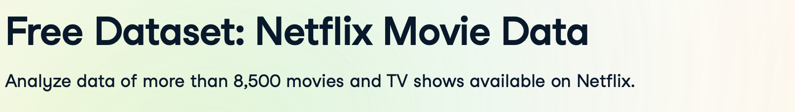
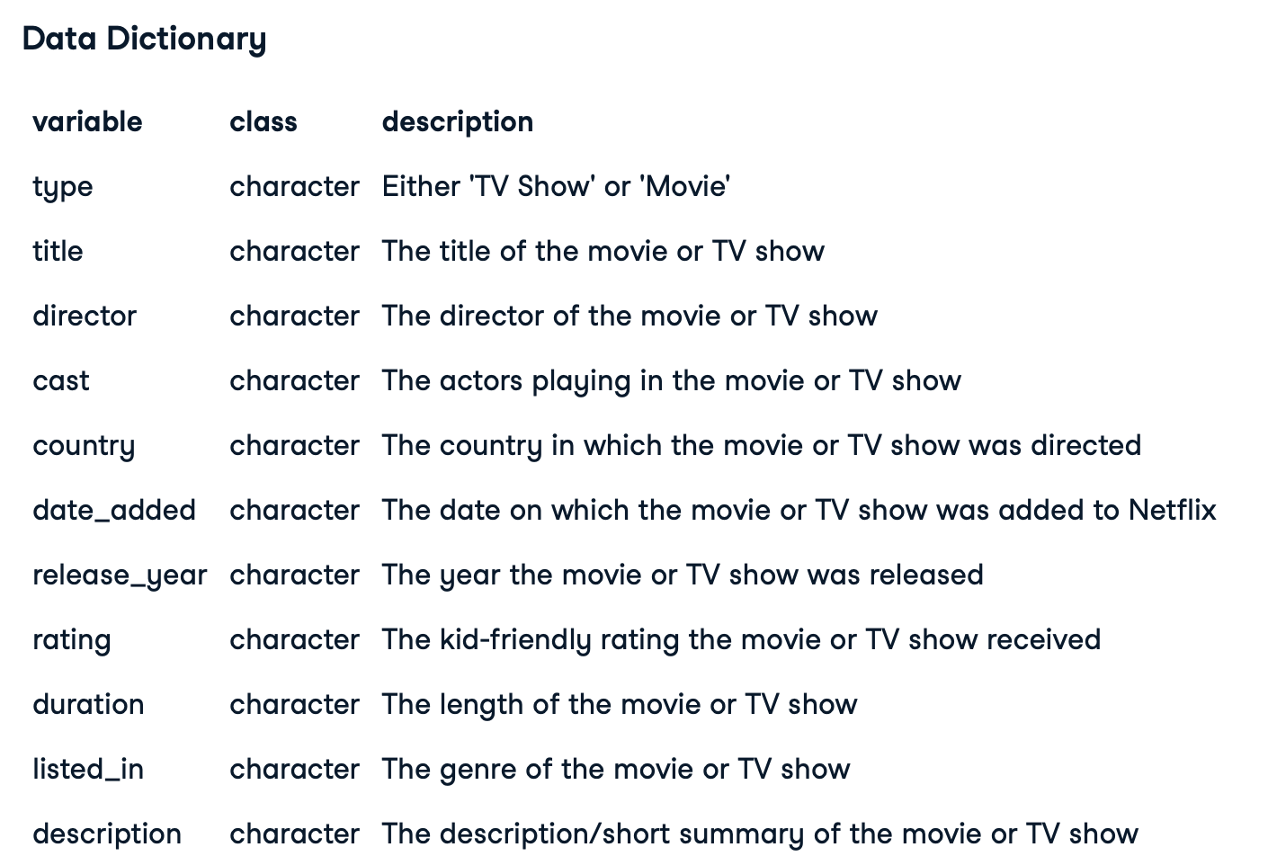
The Data: Datacamp.com
https://www.datacamp.com/datalab/datasets/dataset-r-netflix-movie-data

Slide 3
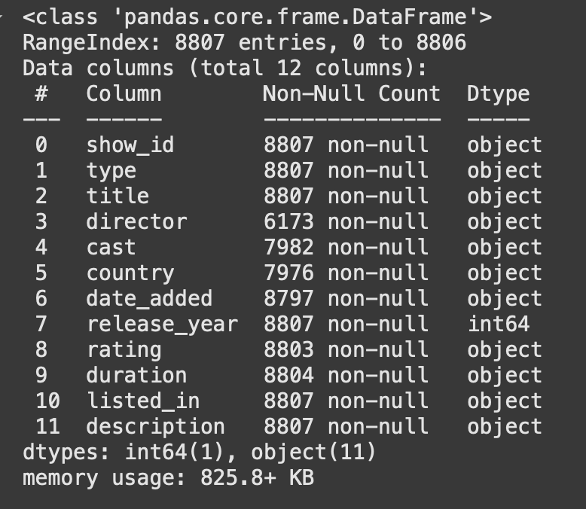
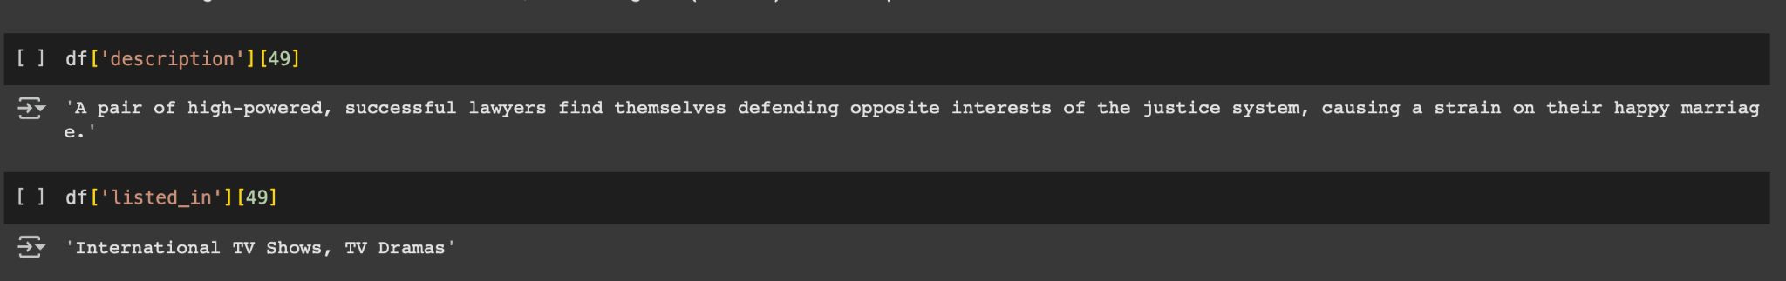
EDA

Slide 4
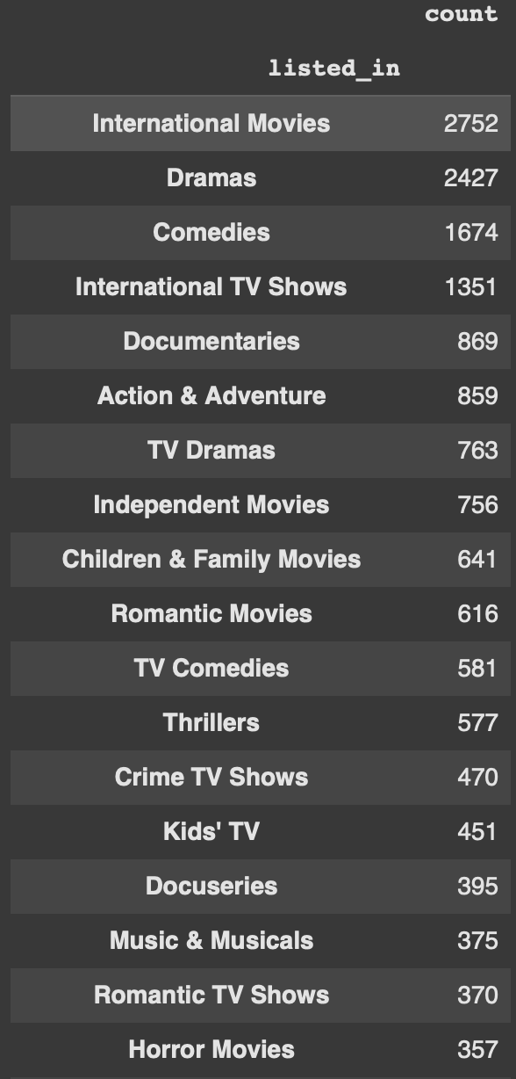
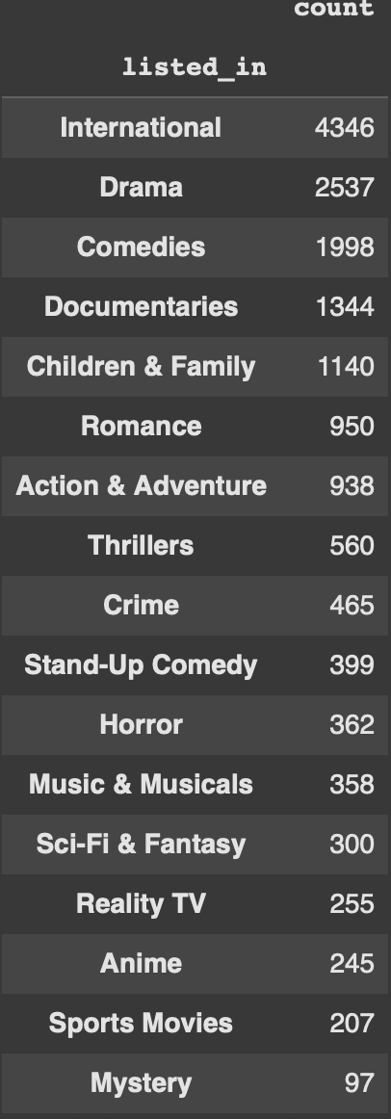
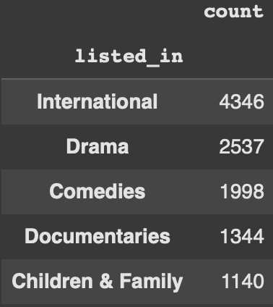
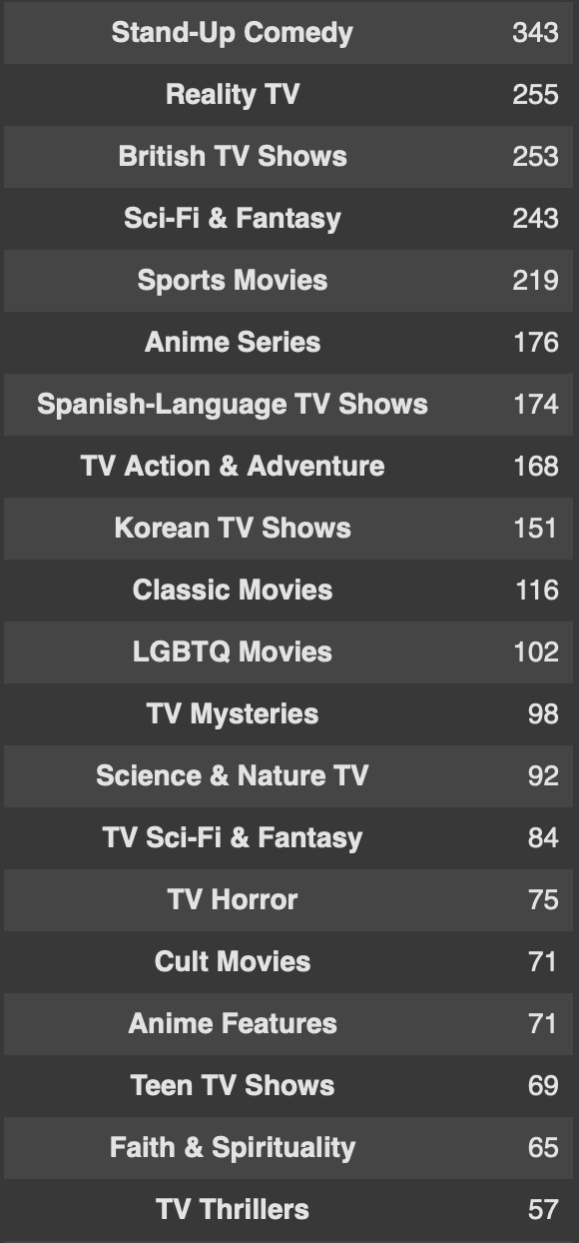
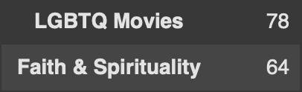
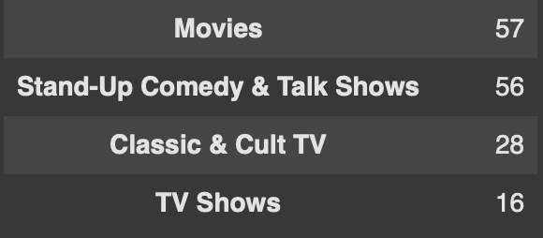
Data Pre-processing
Duplicate descriptions for each listed genre
Group similar genres together
Drop categories without explicit genres
Select classes based on sample size

Slide 5
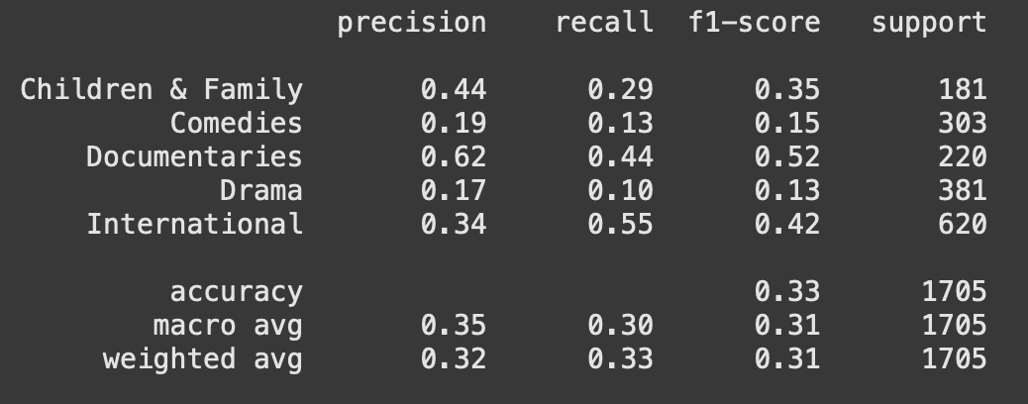
Model 1: Logistic Regression
Train/test split
Tfidfvectorizer

Slide 6
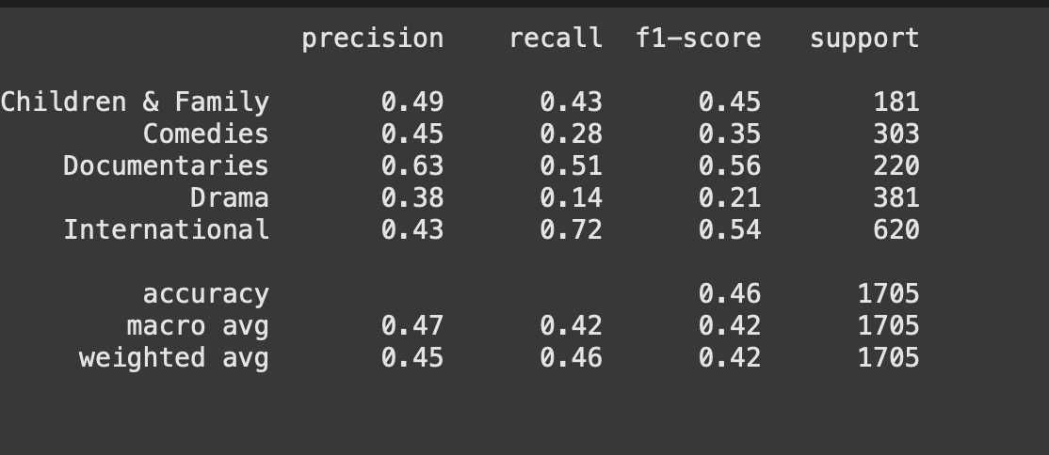
Model 2: Logistic Regression & GloVe

Slide 7
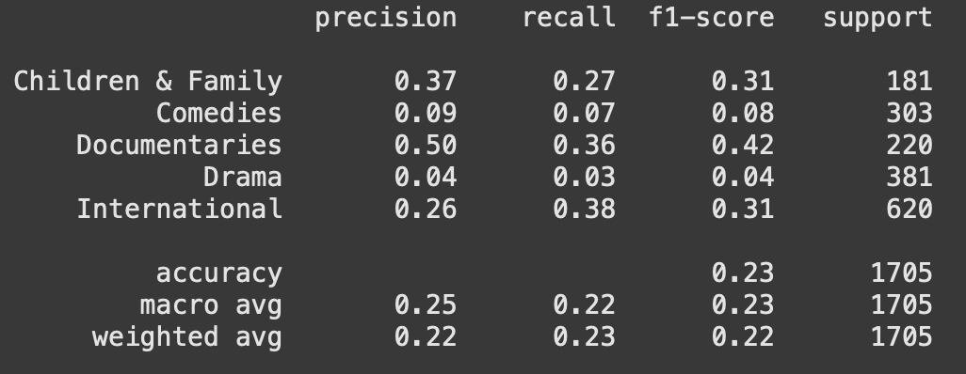
Model 3: Random Forest & GloVe

Slide 8
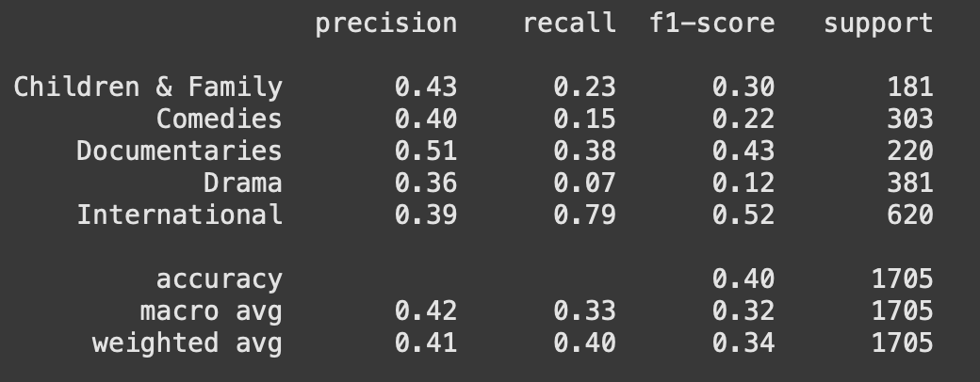
Models with Further Pre-processed Data
Removing stop words
Lemmatization
Nouns only
Logistic Regression & GloVe & Nouns Only Model

Slide 9
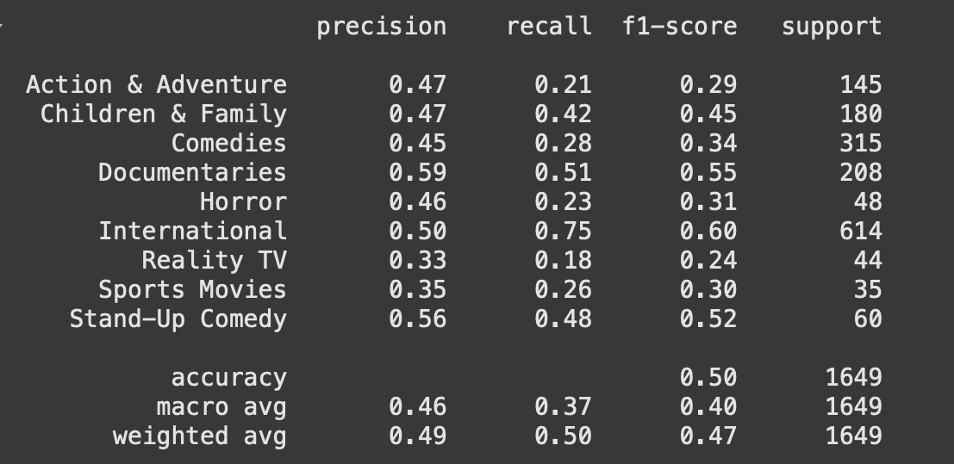
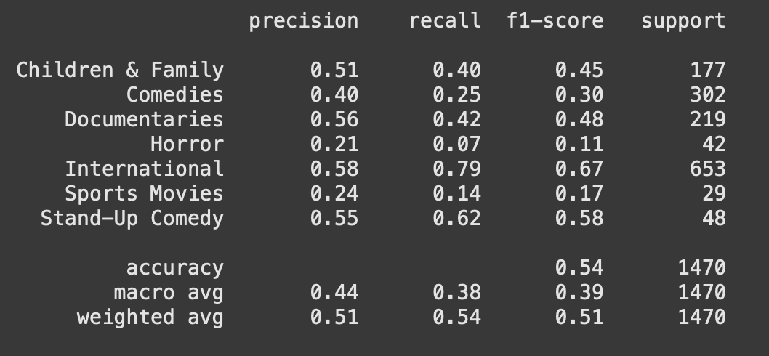
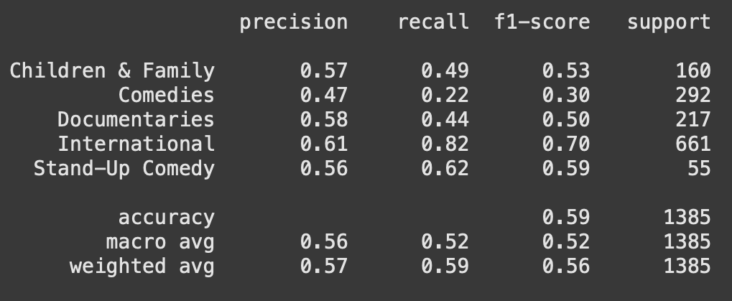
Iteration 1
Iteration 2
Iteration 3

Slide 10
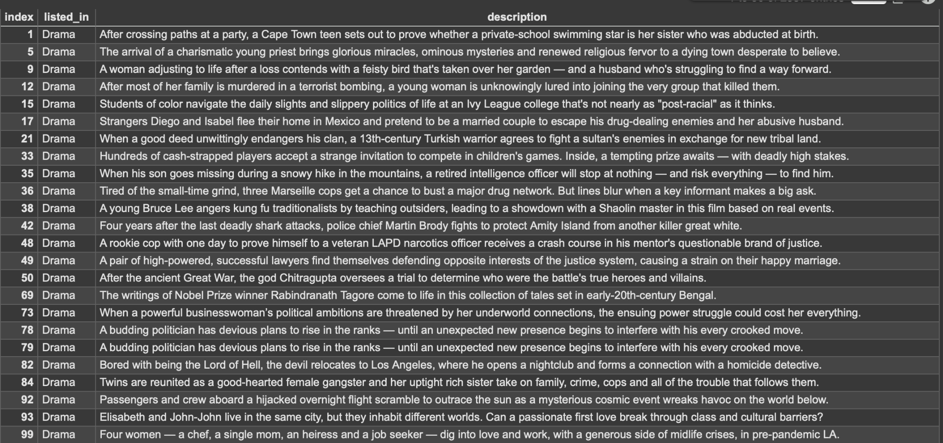
Drama Genre

Slide 11
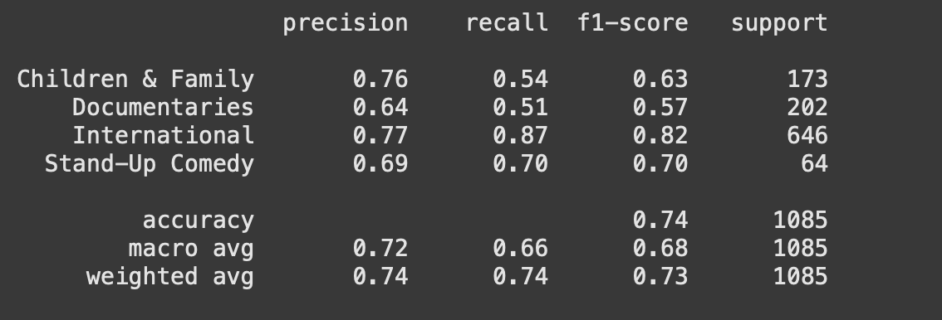
Final Model: Logistic Regression & GloVe

